Slide 1
Improving Tax Administration Through Research-Driven Efficiencies June 18, 2015

Slide 2
Welcome
Eric Toder | Institute Fellow: Urban Institute, and Co-Director: Urban-Brookings Tax Policy Center
Alain Dubois | Deputy Director: IRS Office of Research, Analysis, and Statistics
John A. Koskinen | Commissioner of Internal Revenue

Slide 3
Session 1: Innovative Methods for Improving Resource Allocation
Moderator: | Melissa Vigil IRS, RAS, Office of Research
Estimating Marginal Revenue/Cost Curves for Correspondence Audits | Alan Plumley IRS, RAS, Office of Research
Examining the TDA Collectability Curve | Jeff Wilson IRS, Taxpayer Advocate Service
Analysis of Flow-Through Entities Using Social Network Analysis Techniques | Shannon Chen University of Texas at Austin
Discussant: | Arnie Greenland University of Maryland

Slide 4

Estimating and Using Marginal Revenue/Cost Functions for Correspondence Audits
Alan Plumley
18 June 2015
Team:
Ron Hodge, Kyle Richison, and Getaneh Yismaw (RAS:R)
Nicole Misek, Matt Olson, and Sanith Wijesinghe (MITRE)

Slide 5
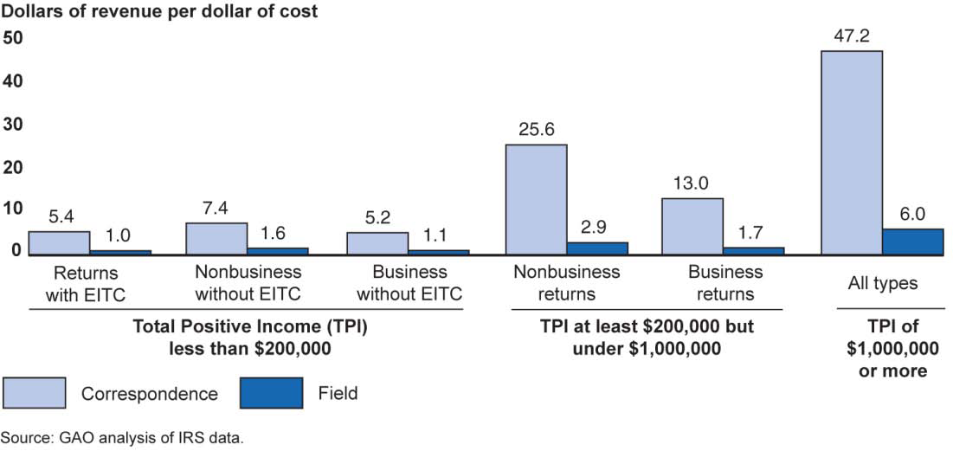
Government Accountability Office:
“IRS Could Significantly Increase Revenues by Better Targeting Enforcement Resources” (December 2012)
Estimating Marginal Revenue/Cost

Slide 6
Government Accountability Office:
“A hypothetical shift of a small share of resources (about $124 million) from exams of tax returns in less productive groups… to exams in the more productive groups could have increased direct revenue by $1 billion… (as long as the average ratio of direct revenue to cost for each category of returns did not change).”
Slope = Marginal Revenue/Cost at Point A
The average R/C is constant only if we select cases randomly.
If we’re successful in giving priority to the most cost-effective cases, then the average should decline as we increase the budget.
Making allocations based on average R/C overstates the impact of a change in budget.
A
(e.g., last year’s overall result)
Cumulative Revenue ($)
Slope = Average Revenue/Cost at Point A
Cumulative Cost ($)
Estimating Marginal Revenue/Cost

Slide 7
Is There Evidence of Marginality?
That is, are the methods used to prioritize potential audit inventory better than random selection?
If we had to reduce the number audited, would we tend to avoid the least cost-effective ones?
If we were able to increase the number audited, would the additional ones be less cost-effective than the ones already selected?
Answer: YES, there is evidence of marginality!
Estimating Marginal Revenue/Cost

Slide 8
Current Research Project
Focused on correspondence (rather than face-to-face) audits
Many categories of correspondence audits (“projects”), defined by what tax return line item is being questioned
Begin by trying to improve resource allocation across the projects assuming no change to operational selection system
Estimating Marginal Revenue/Cost

Slide 9
Method (for a given project and tax year)
Step 1: Identify for each closed audit:
The tax revenue collected from the audit;
An estimate of the cost to identify, assess, and collect that revenue (from time applied, series, grade, etc.); and
The value of the variable used operationally to assign priority to the audit.
Step 2: Sort all closed audits in declining order of the prioritization variable.
When a return was audited is generally not a proxy for priority.
Step 3: Derive for each audit the cumulative revenue and cumulative cost of all returns audited having same or greater priority.
Step 4: Plot cumulative revenue vs. cumulative cost.
Estimating Marginal Revenue/Cost

Slide 10
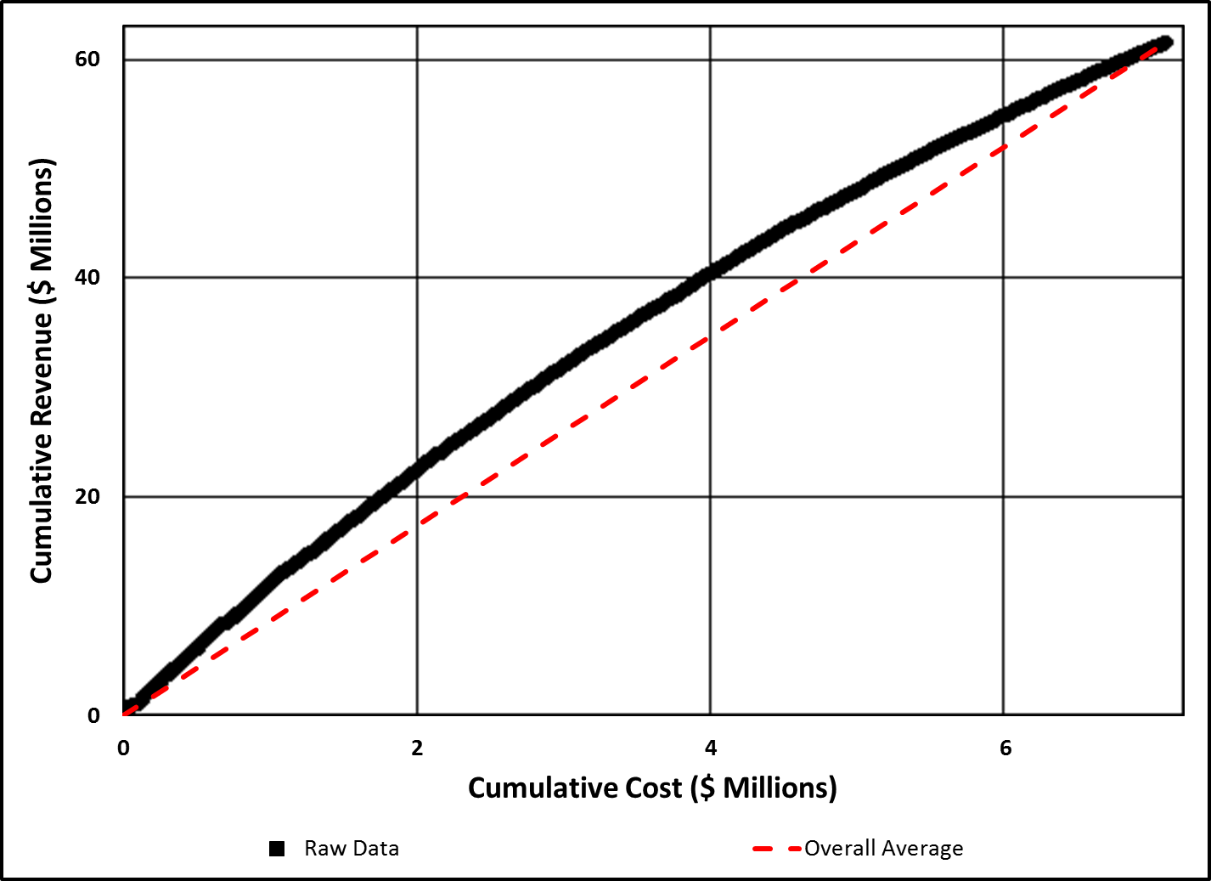
Correspondence Audit Project Code A2, Tax Year 2006
The curvature away from the average line is a measure of marginality—the power of the prioritization method to identify returns with higher revenue/cost (at the left).
Estimating Marginal Revenue/Cost

Slide 11
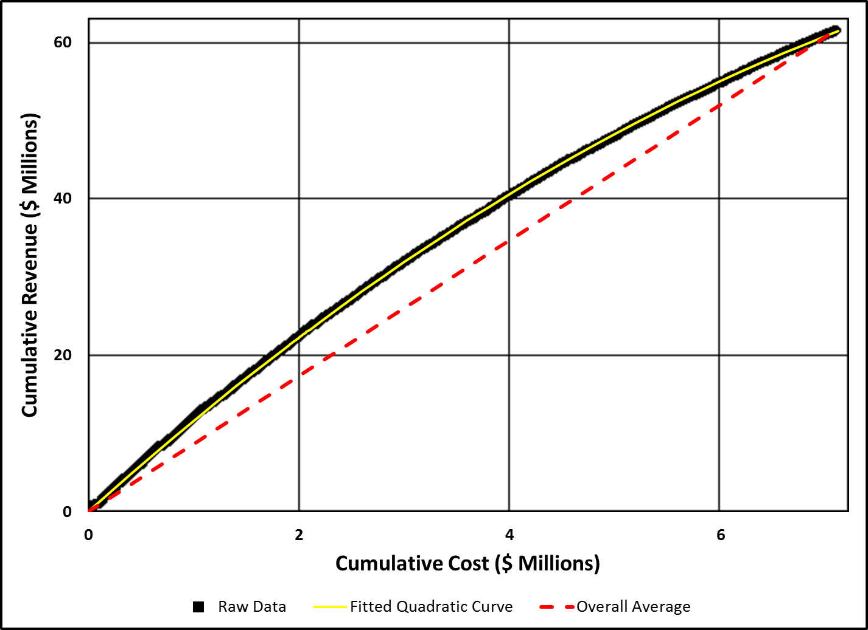
Correspondence Audit Project Code A2, Tax Year 2006
Step 5: Fit a curve through the plot. A simple quadratic curve displayed an excellent fit for most projects.
Estimating Marginal Revenue/Cost

Slide 12
Deriving Marginal Revenue/Cost Functions
Slope = Marginal Revenue/Cost at Point A
Step 6: Mathematically derive the marginal Revenue/Cost curve (the slope of the cumulative curve at each point)
If the cumulative plot is a quadratic curve, then marginal R/C declines linearly as a function of cumulative cost.
A
Cumulative Revenue ($)
Returns sorted in declining order of priority
Cumulative Cost ($)
Estimating Marginal Revenue/Cost

Slide 13
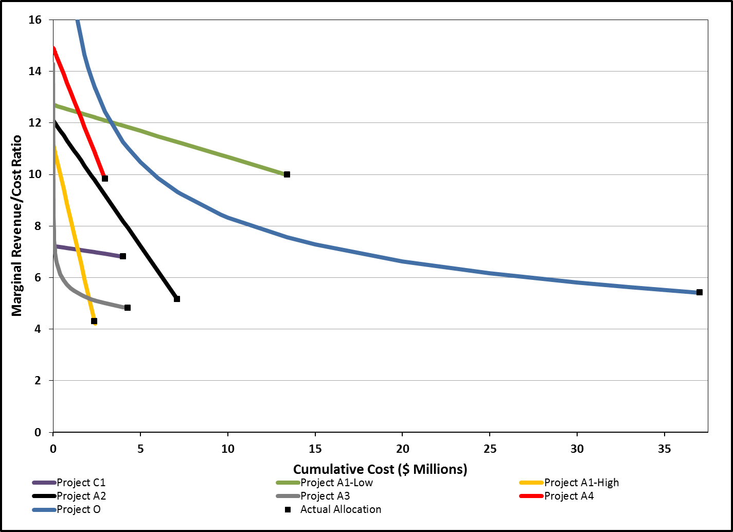
Marginal Revenue/Cost as a Function of Budget, Tax Year 2006
As more budget is applied to a project, the marginal R/C declines.
Greater curvature in the Cumulative Revenue vs. Cumulative Cost plot corresponds to steeper slope in the Marginal R/C plot.
How should the available budget be allocated to these projects to maximize direct revenue?
Estimating Marginal Revenue/Cost

Slide 14
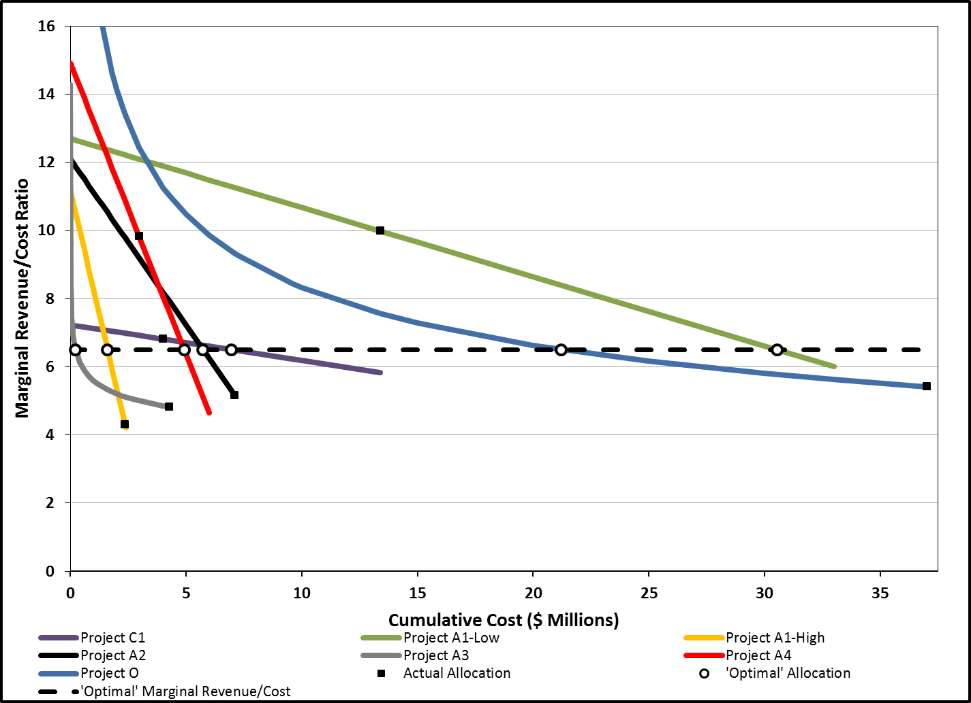
Marginal Revenue/Cost as a Function of Budget, Tax Year 2006
Direct revenue is maximized when the marginal R/C ratio is the same for all projects.
Otherwise, revenue could be increased by shifting resources from projects with low MR/C to those with higher MR/C.
Estimating Marginal Revenue/Cost

Slide 15
Actual vs. Optimal* Revenue and Cost ($ M)
Project | Actual Allocation |  |  |  |  | Optimal* Allocation |  |  |  |  | Change in Cost | Change in Revenue
 | Total Revenue | Total Cost | Net Revenue | Average Rev/Cost | Marginal Rev/Cost | Total Revenue | Total Cost | Net Revenue | Average Rev/Cost | Marginal Rev/Cost
C1 | $27.6 | $4.0 | $23.6 | 6.90 | 6.81 | $47.7 | $7.0 | $40.8 | $6.87 | 6.51 | $2.9 | $20.1
A1-Lo | $151.9 | $13.4 | $138.5 | 11.33 | 9.98 | $293.3 | $30.5 | $262.7 | $9.60 | 6.51 | $17.1 | $141.4
A1-Hi | $18.6 | $2.4 | $16.2 | 7.83 | 4.29 | $14.2 | $1.6 | $12.6 | $8.84 | 6.51 | -$0.8 | -$4.3
A2 | $61.7 | $7.1 | $54.6 | 8.67 | 5.16 | $53.3 | $5.7 | $47.6 | $9.30 | 6.51 | -$1.4 | -$8.4
A3 | $21.9 | $4.3 | $17.6 | 5.12 | 4.82 | $1.6 | $0.2 | $1.4 | $7.24 | 6.51 | -$4.1 | -$20.3
A4 | $36.3 | $3.0 | $33.4 | 12.22 | 9.83 | $52.7 | $4.9 | $47.8 | $10.71 | 6.51 | $1.9 | $16.3
O | $287.1 | $37.0 | $250.0 | 7.75 | 5.41 | $205.7 | $21.2 | $184.5 | $9.70 | 6.51 | -$15.8 | -$81.4
Total | $605.1 | $71.2 | $533.9 | 8.50 |  | $668.6 | $71.2 | $597.4 | $9.39 | 6.51 | $0.0 | $63.5
* These are “optimal” allocations only in the sense that they maximize net direct revenue in the absence of any constraints. They are not truly optimal since they don’t account for indirect effects, other benefits or costs, constraints, or valuations of benefits and costs other than dollars.
Estimating Marginal Revenue/Cost

Slide 16
Next Steps
Work with Campus Exam and OCA to incorporate MR/MC functions in the Exam Planning Scenario Tool to support the FY16 Exam Plan.
Identify constraints
How much can we expand projects with high MR/MC?
How easily can examiners work different projects?
Make assumptions about indirect effects
Minimum coverage constraints, etc.
Improve workload selection (screening, prioritization variables)
Estimating Marginal Revenue/Cost

