Slide 1
Joining or Resisting the Status Quo: Social Norms and Deliberate Choice to Encourage Tax Compliance
Stewart Kettle | Marco Hernandez | Simon Ruda | Michael Sanders
University of Bristol | World Bank | Behavioural Insights Team | Harvard Kennedy School
IRS-TPC Research Conference
June 18, 2015

Slide 2
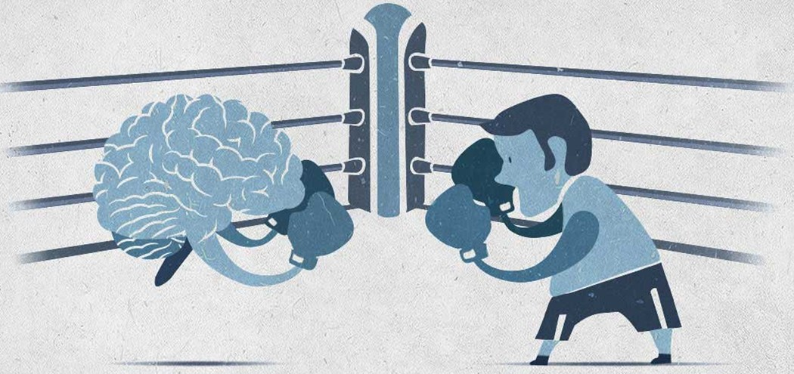

Slide 3
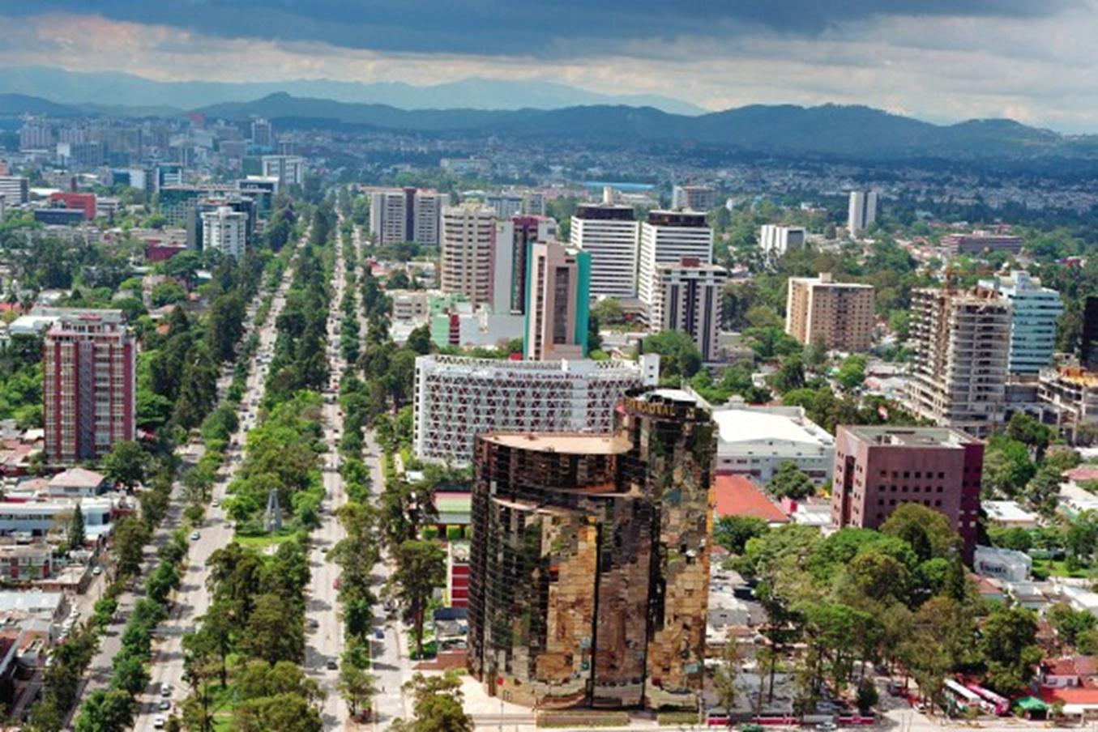



Guatemala

Slide 4
The Guatemalan State
Public Revenues and Spending (2011 – 2013, % GDP)
Ranking
186/186
Ranking
186/186
Revenues
Spending
Ranking
186/186
Ranking
186/186
Source: Guatemala Economic DNA (World Bank, 2014).

Slide 5

How might we increase tax compliance at a low cost, and without new legislation?

Slide 6
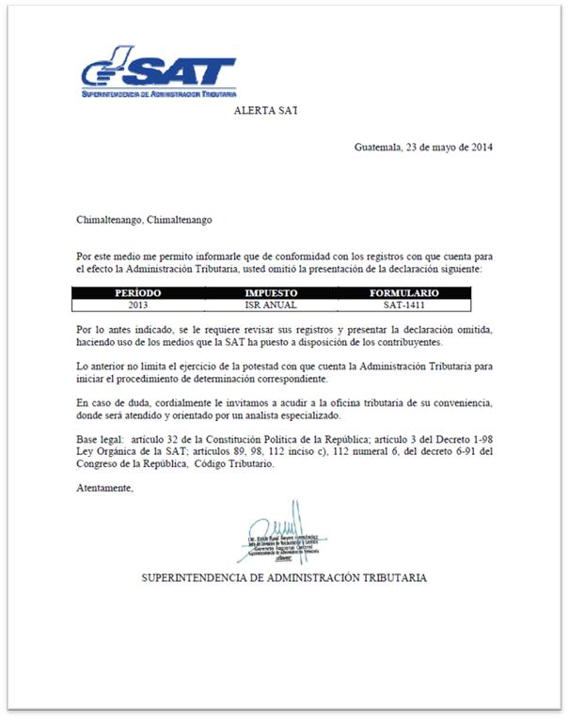
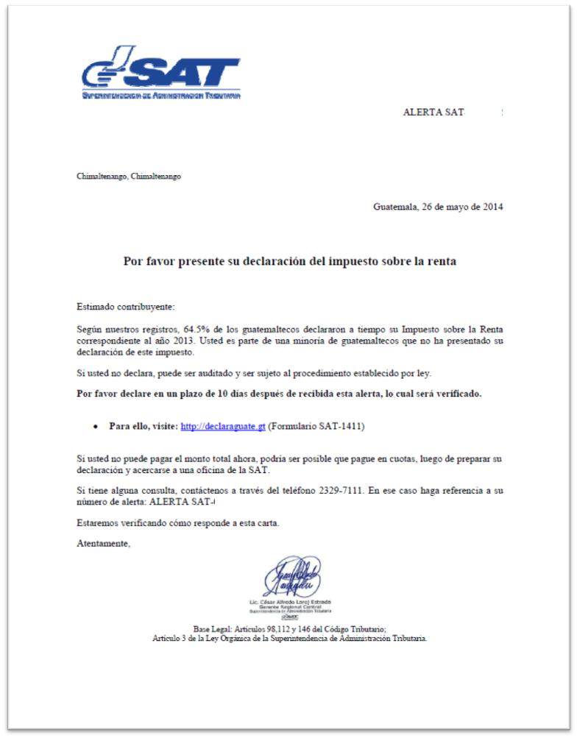
Social Norm:
“According to our records, 64.5% of Guatemalans declared their income tax for the year 2013 on time. You a part of the minority of Guatemalans who are yet to declare for this tax.”

Slide 7
Behavioral Insights:
“If you do not declare, you may be audited and could face the procedure established by law.”
Deliberate Choice:
“Previously we have considered your failure to declare an oversight. However, if you don’t declare now we will consider it an active choice and you may therefore be audited and could face the procedure established by law.”
National Pride:
“You are a Guatemalan citizen and Guatemala needs you. Be a good citizen and submit the 2013 annual return of your Income Tax…Are you going to support your country?”

Slide 8
Descriptive statistics

Slide 9
Percentage of taxpayers that paid their Income Tax (after 11 weeks)
n=43,387
43% increase in payment
Note: Green bars denote point estimates significantly different from the original Tax Authority letter at 1% level of significance.

Slide 10
Percentage of taxpayers that paid depending on whether they received a letter
67% increase in payment rate vs. the control group

Slide 11
Percentage of taxpayers that paid:
Firms vs. Individuals (LATE)

Slide 12
Amount of tax received by letter sent (after 12 months)
Intention to Treat

Slide 13
Long-Term Impact

Slide 14
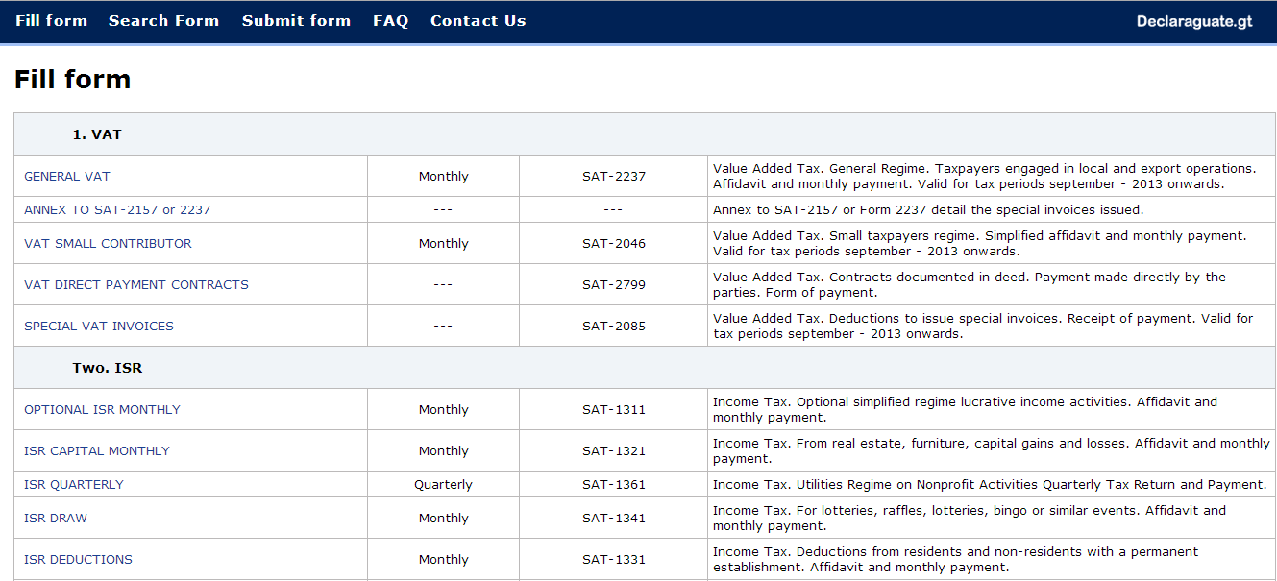
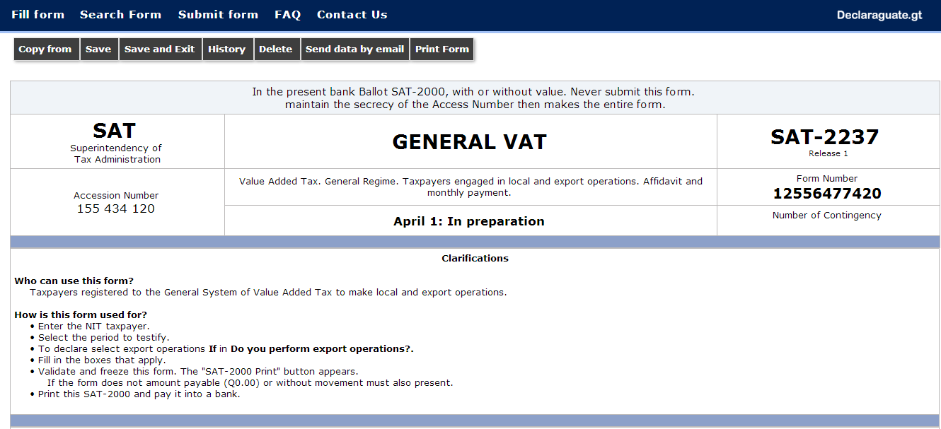
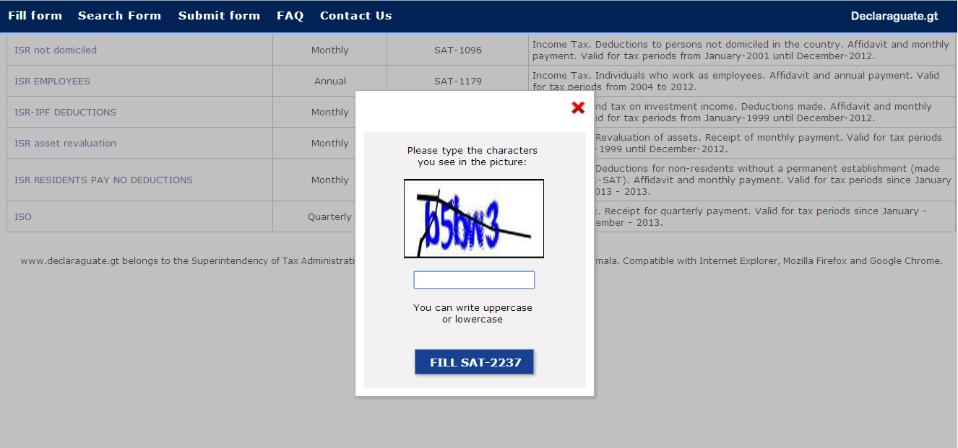
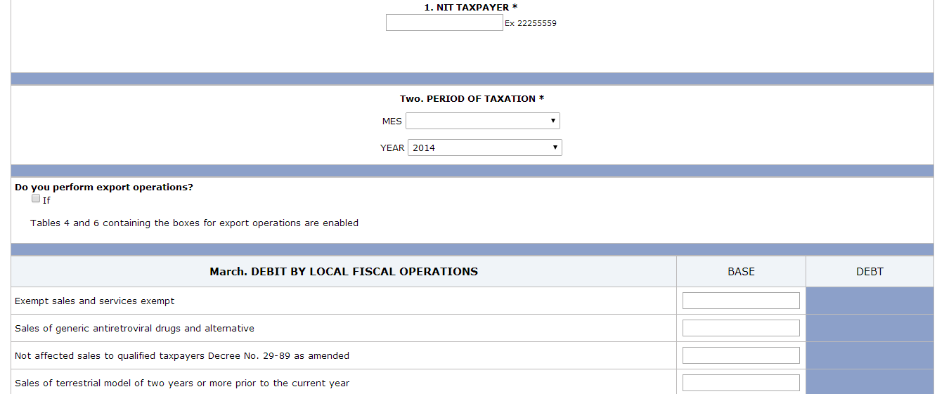
CAPTCHA Experiment

Slide 15
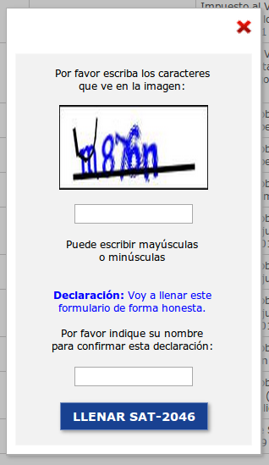
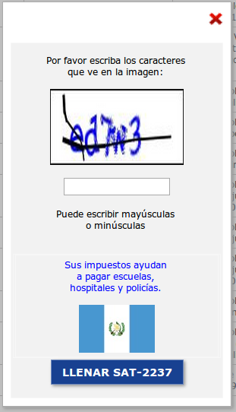
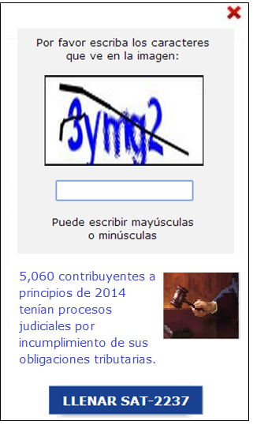
#1
Honesty Declaration
#2
Public Good
#3
Punishment

Slide 16
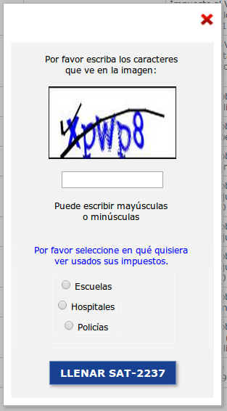
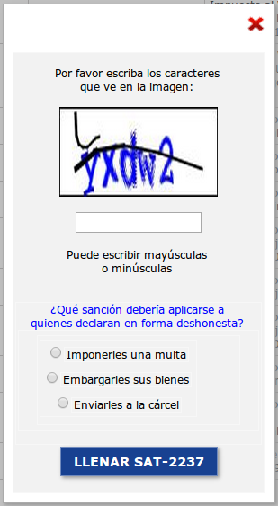
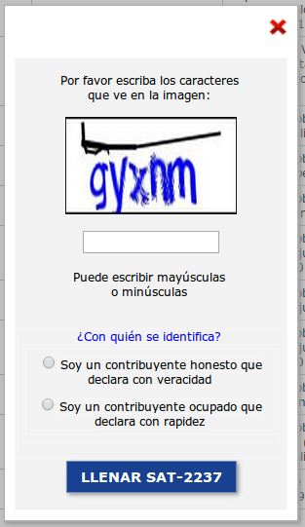
#4
Selection of Public Good
#5
Selection of Punishment
#6
“I am Honest”
Selection

Slide 17

Takeaways
Social norms and deliberate choice letters had positive impacts on the rate of declaration and the rate of payment
Practical, low-cost, and evidence-based
Great potential for scalability

Slide 18

Thank You
Marco Hernandez
marcohernandez@worldbank.org

